Slide 1
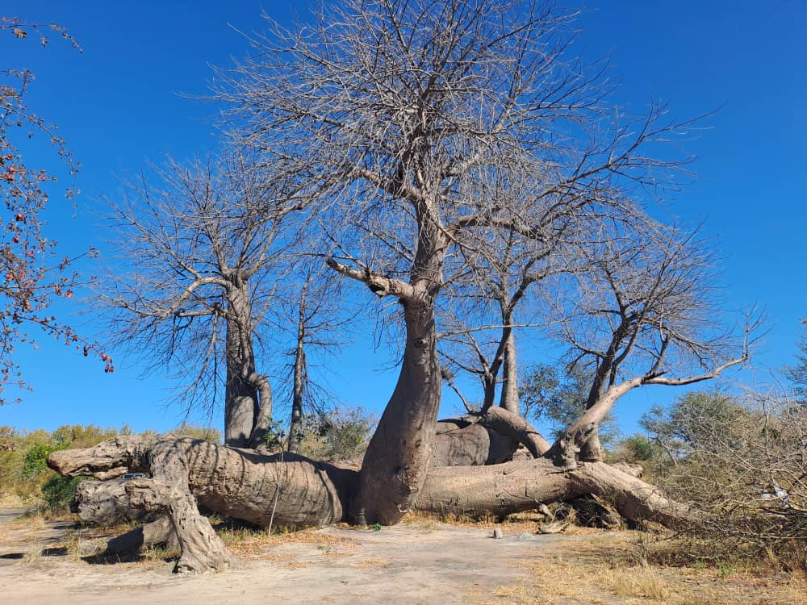
Champion trees in Namibia

Slide 2
What is a Champion tree?
Champion trees refer to extraordinary single trees or groups of trees which have been assigned special status.
Status is assigned due to:
Biological attributes
Age
Historical/Heritage value

Slide 3
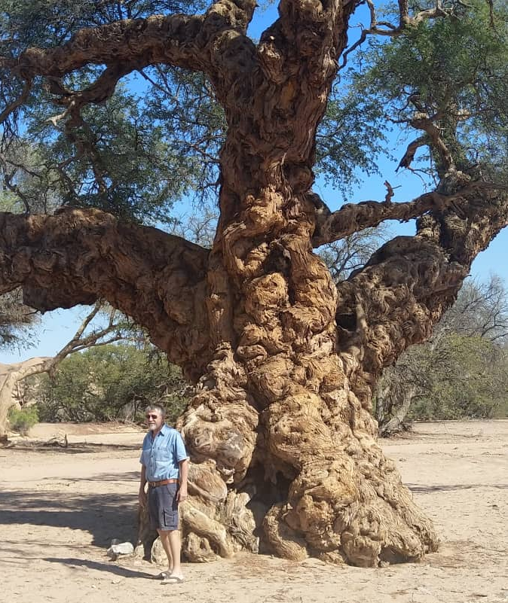
Key parameters for evaluating Champion status are:
Biological attributes
Use established methods to measure:
stem circumference , height and crown size
From these measurements a Size Index is then calculated
Size Index (SI) = √d x h x √2r
Diameter (d) Circumference/3.14
Height (h)
crown spread (2r) average crown width
Age
Date of planting, difficult for indigenous spp in
natural areas
At least 120 years old

Slide 4
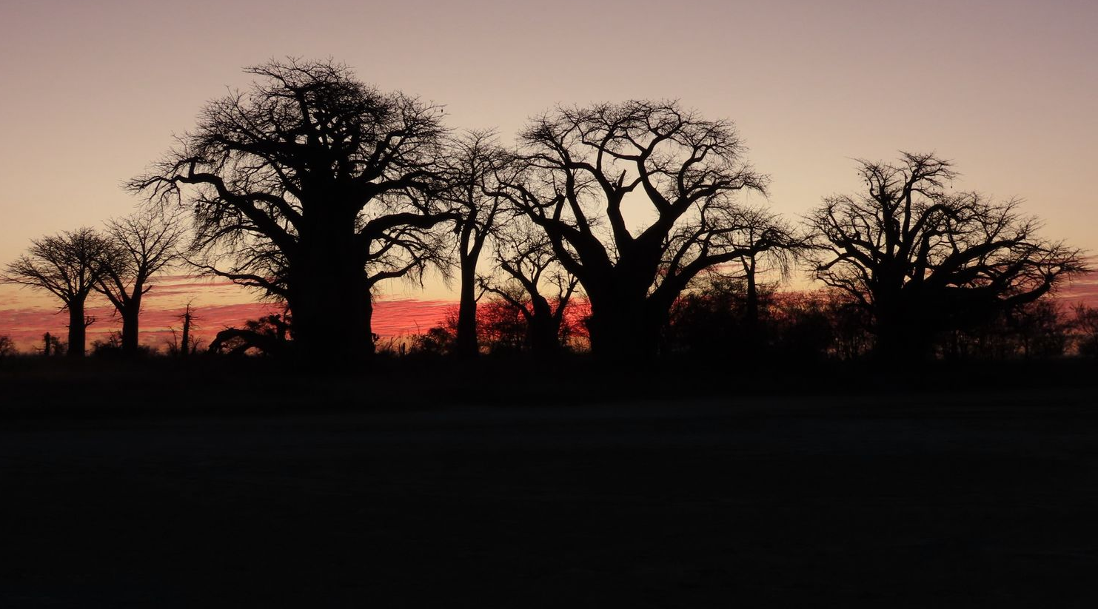
Heritage significance
Aesthetic
Cultural
Economic value
Landscape
Historical

Slide 5
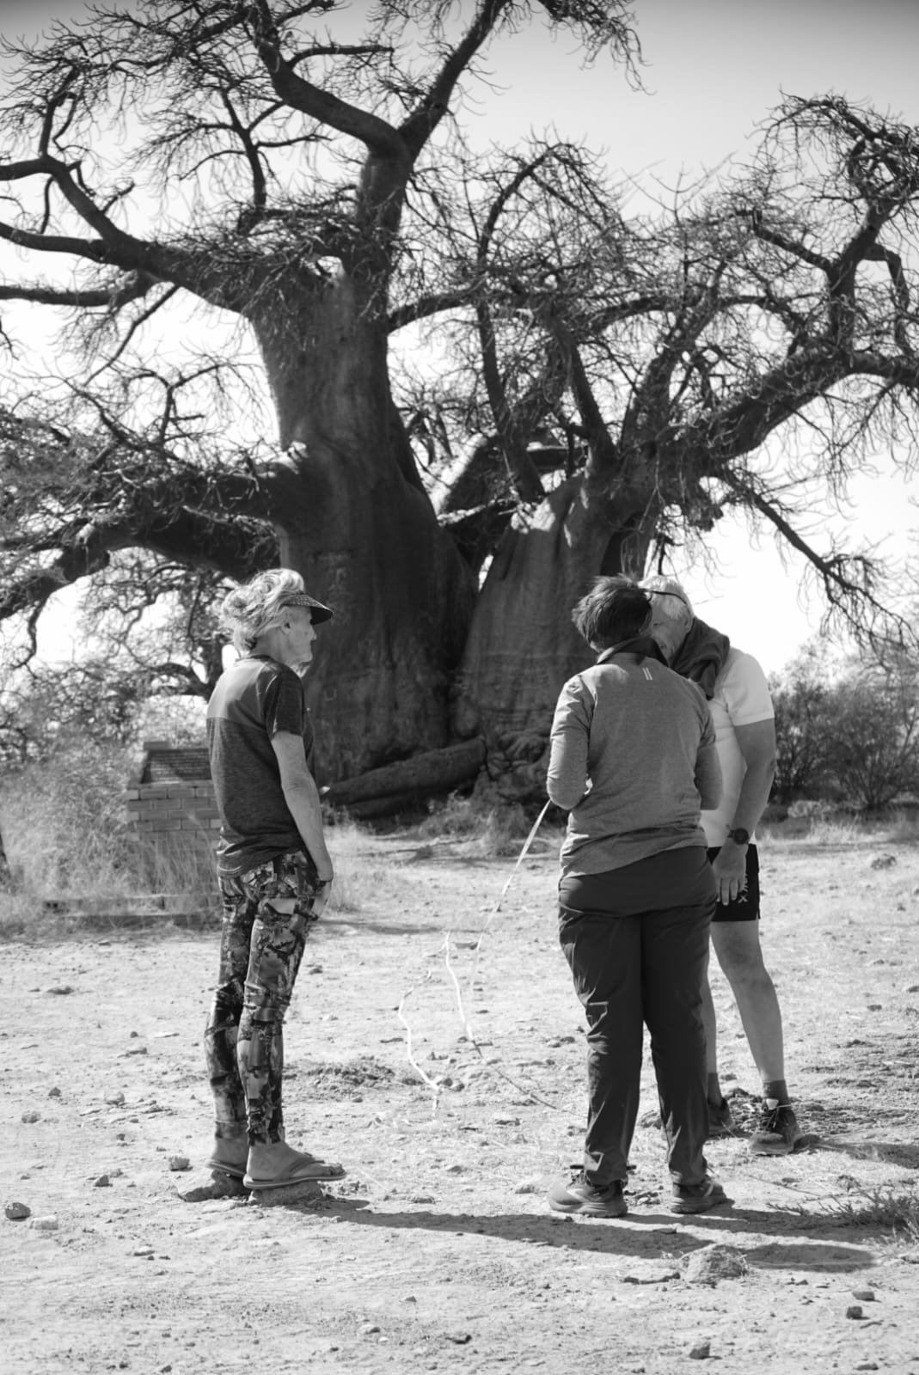
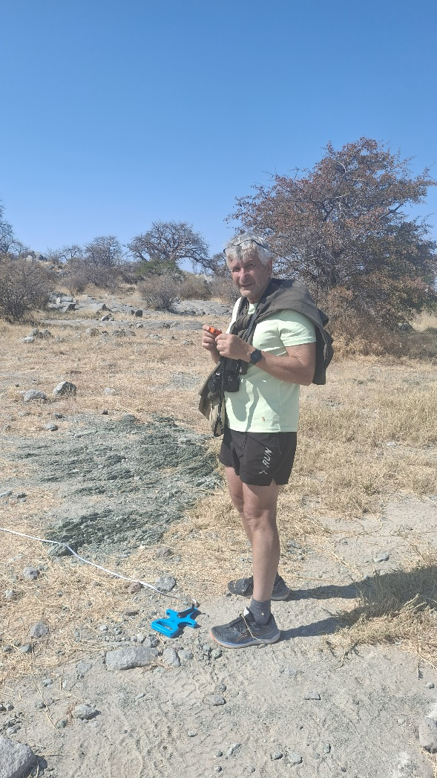
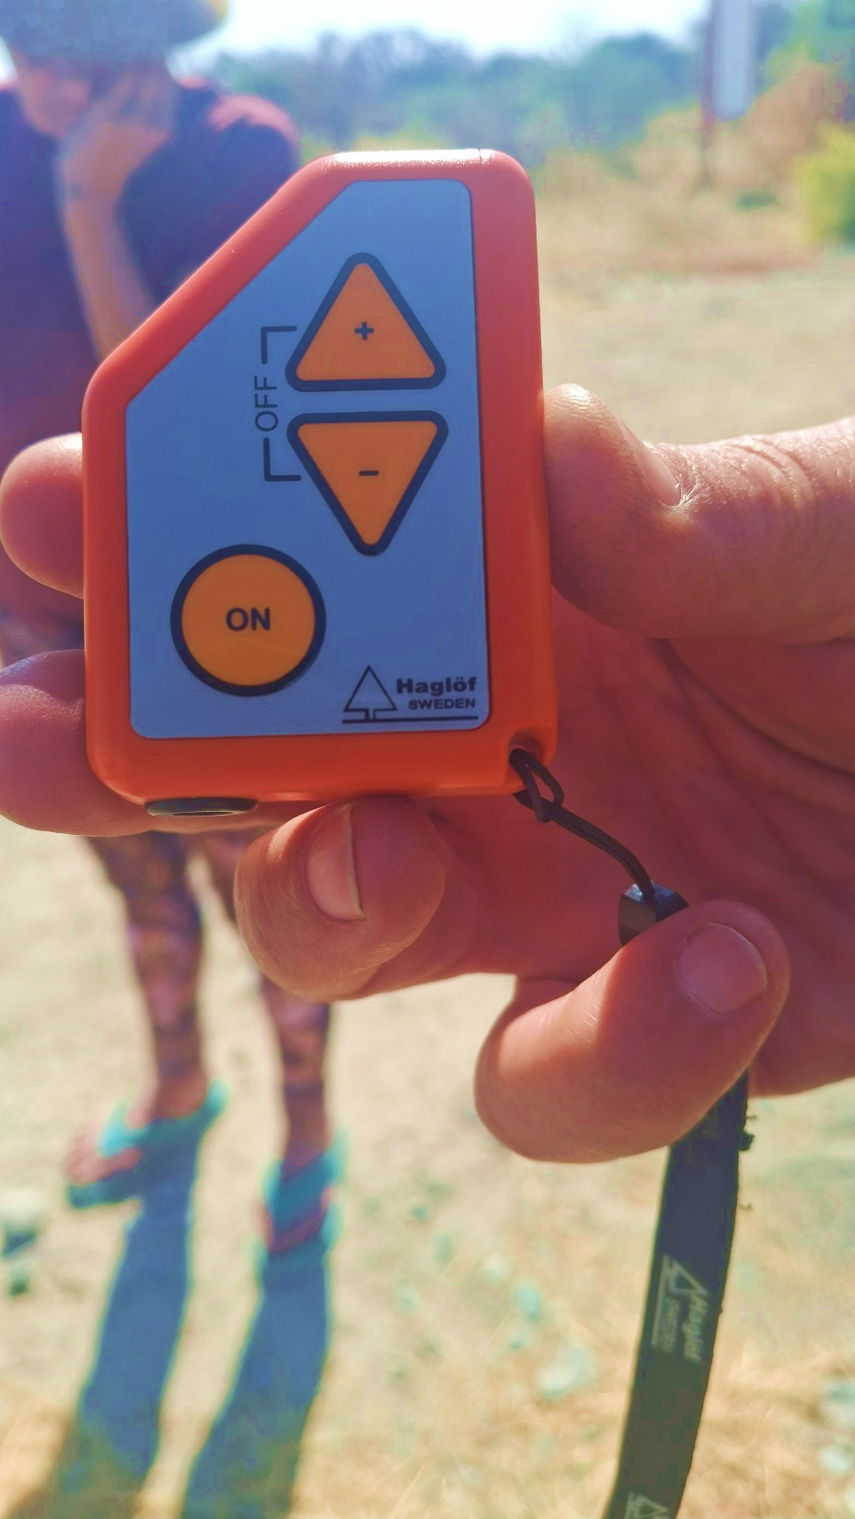
Clinometer

Slide 6
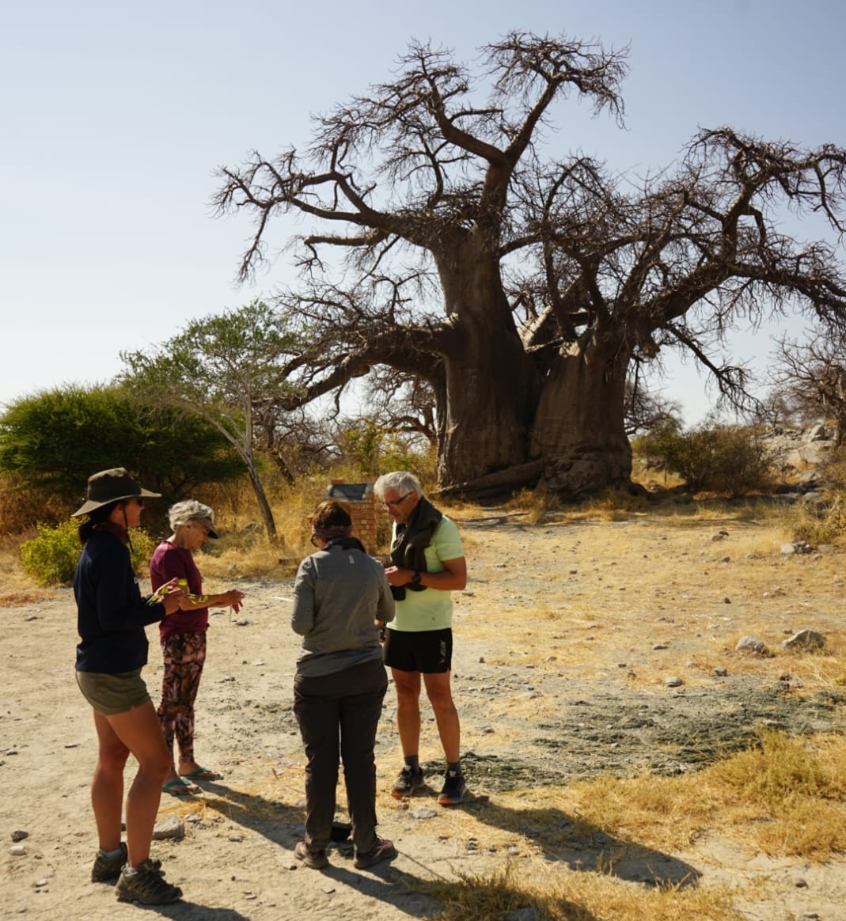
Kubu Island
SI = 225
Size
Tourism value
Conservation value

Slide 7
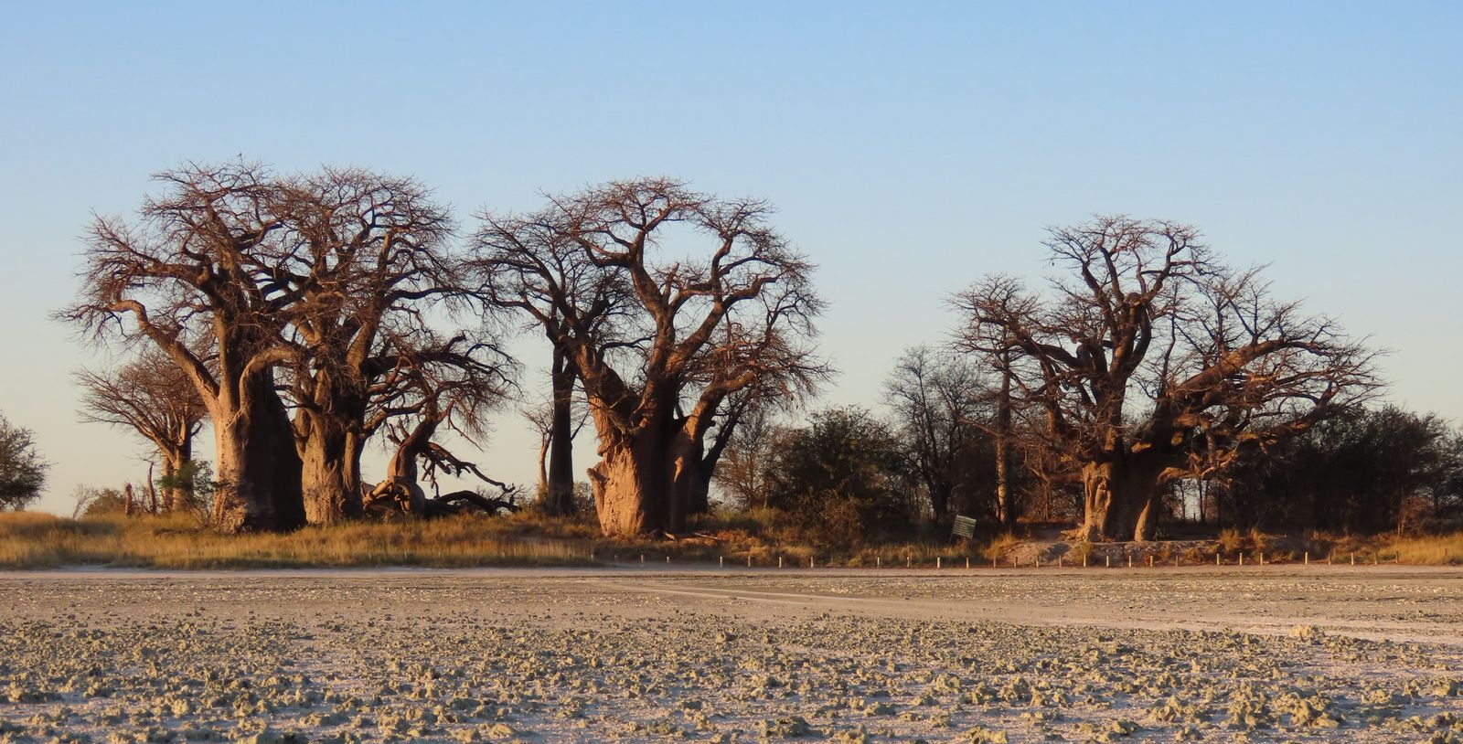
Baines Baobabs
Group of 7 Trees
Thomas Baines
SI = 209
Conservation value

Slide 8
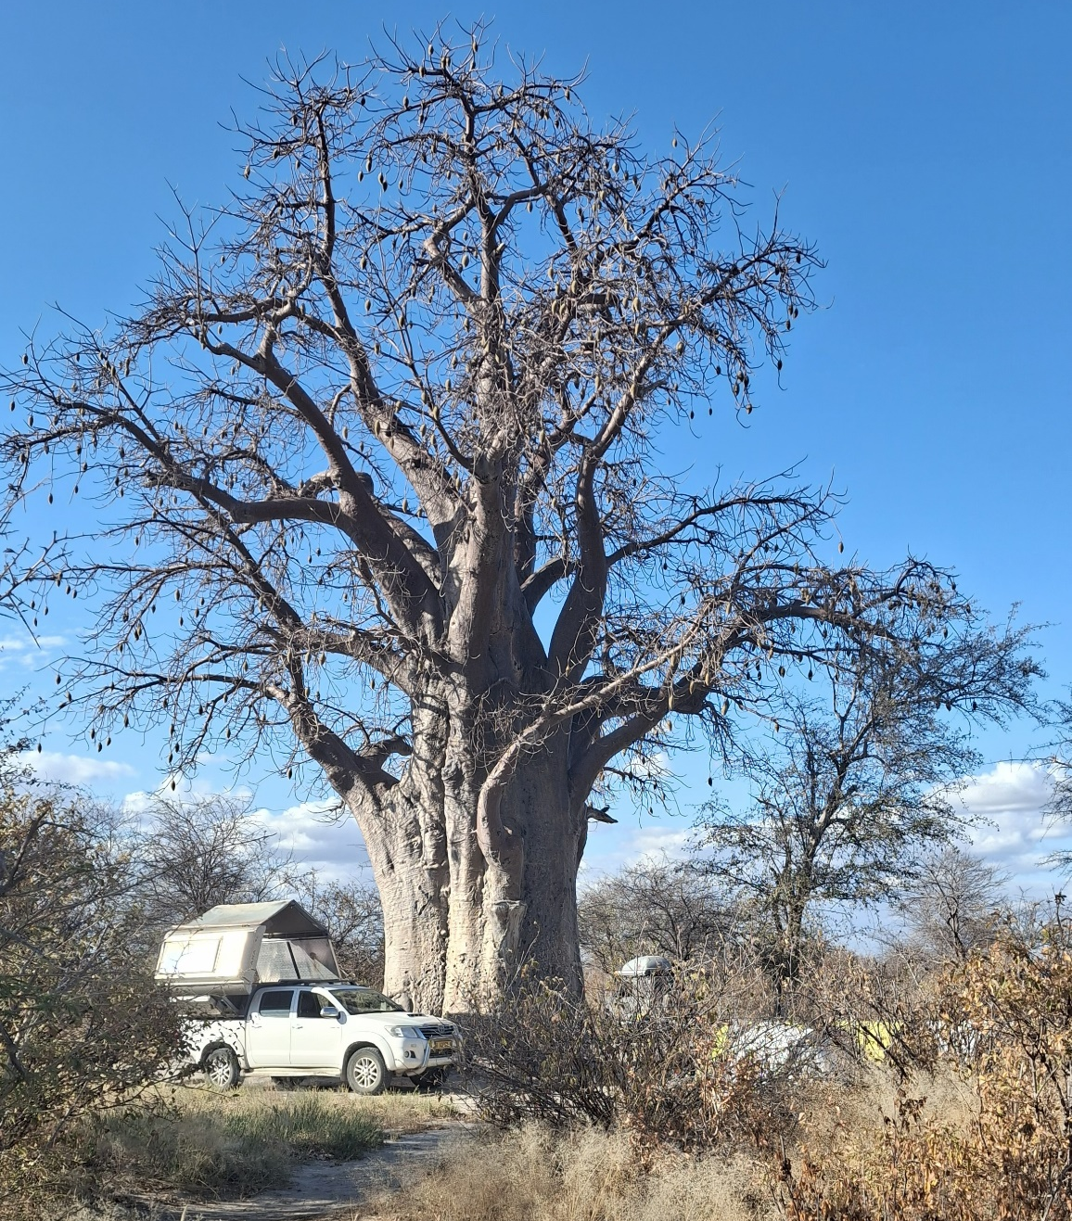
Baines Campsite 3
SI = 161
Tourism value

Slide 9
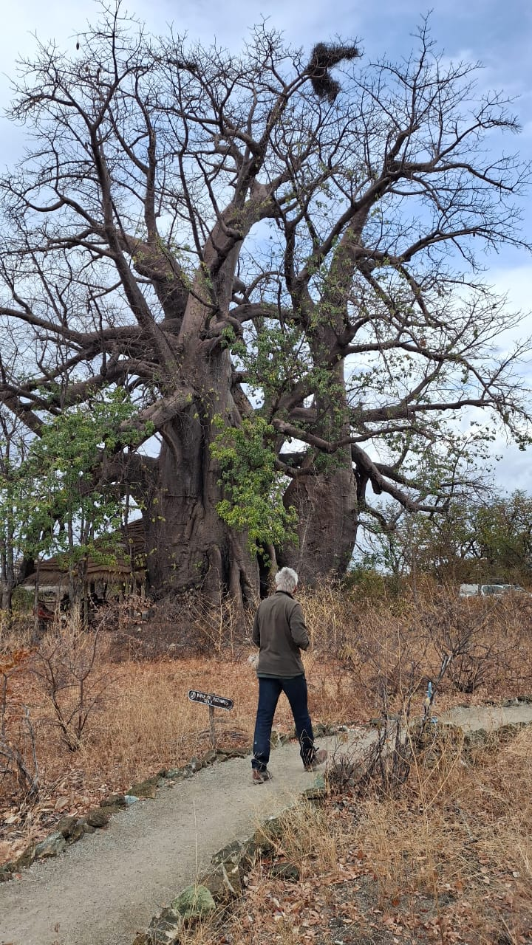
Planet Baobab
SI = 354
Biological attribute
Tourism value
Bar at Planet Baobab (17 trees)
Baobabs close to Makgadikgadi Pans

Slide 10
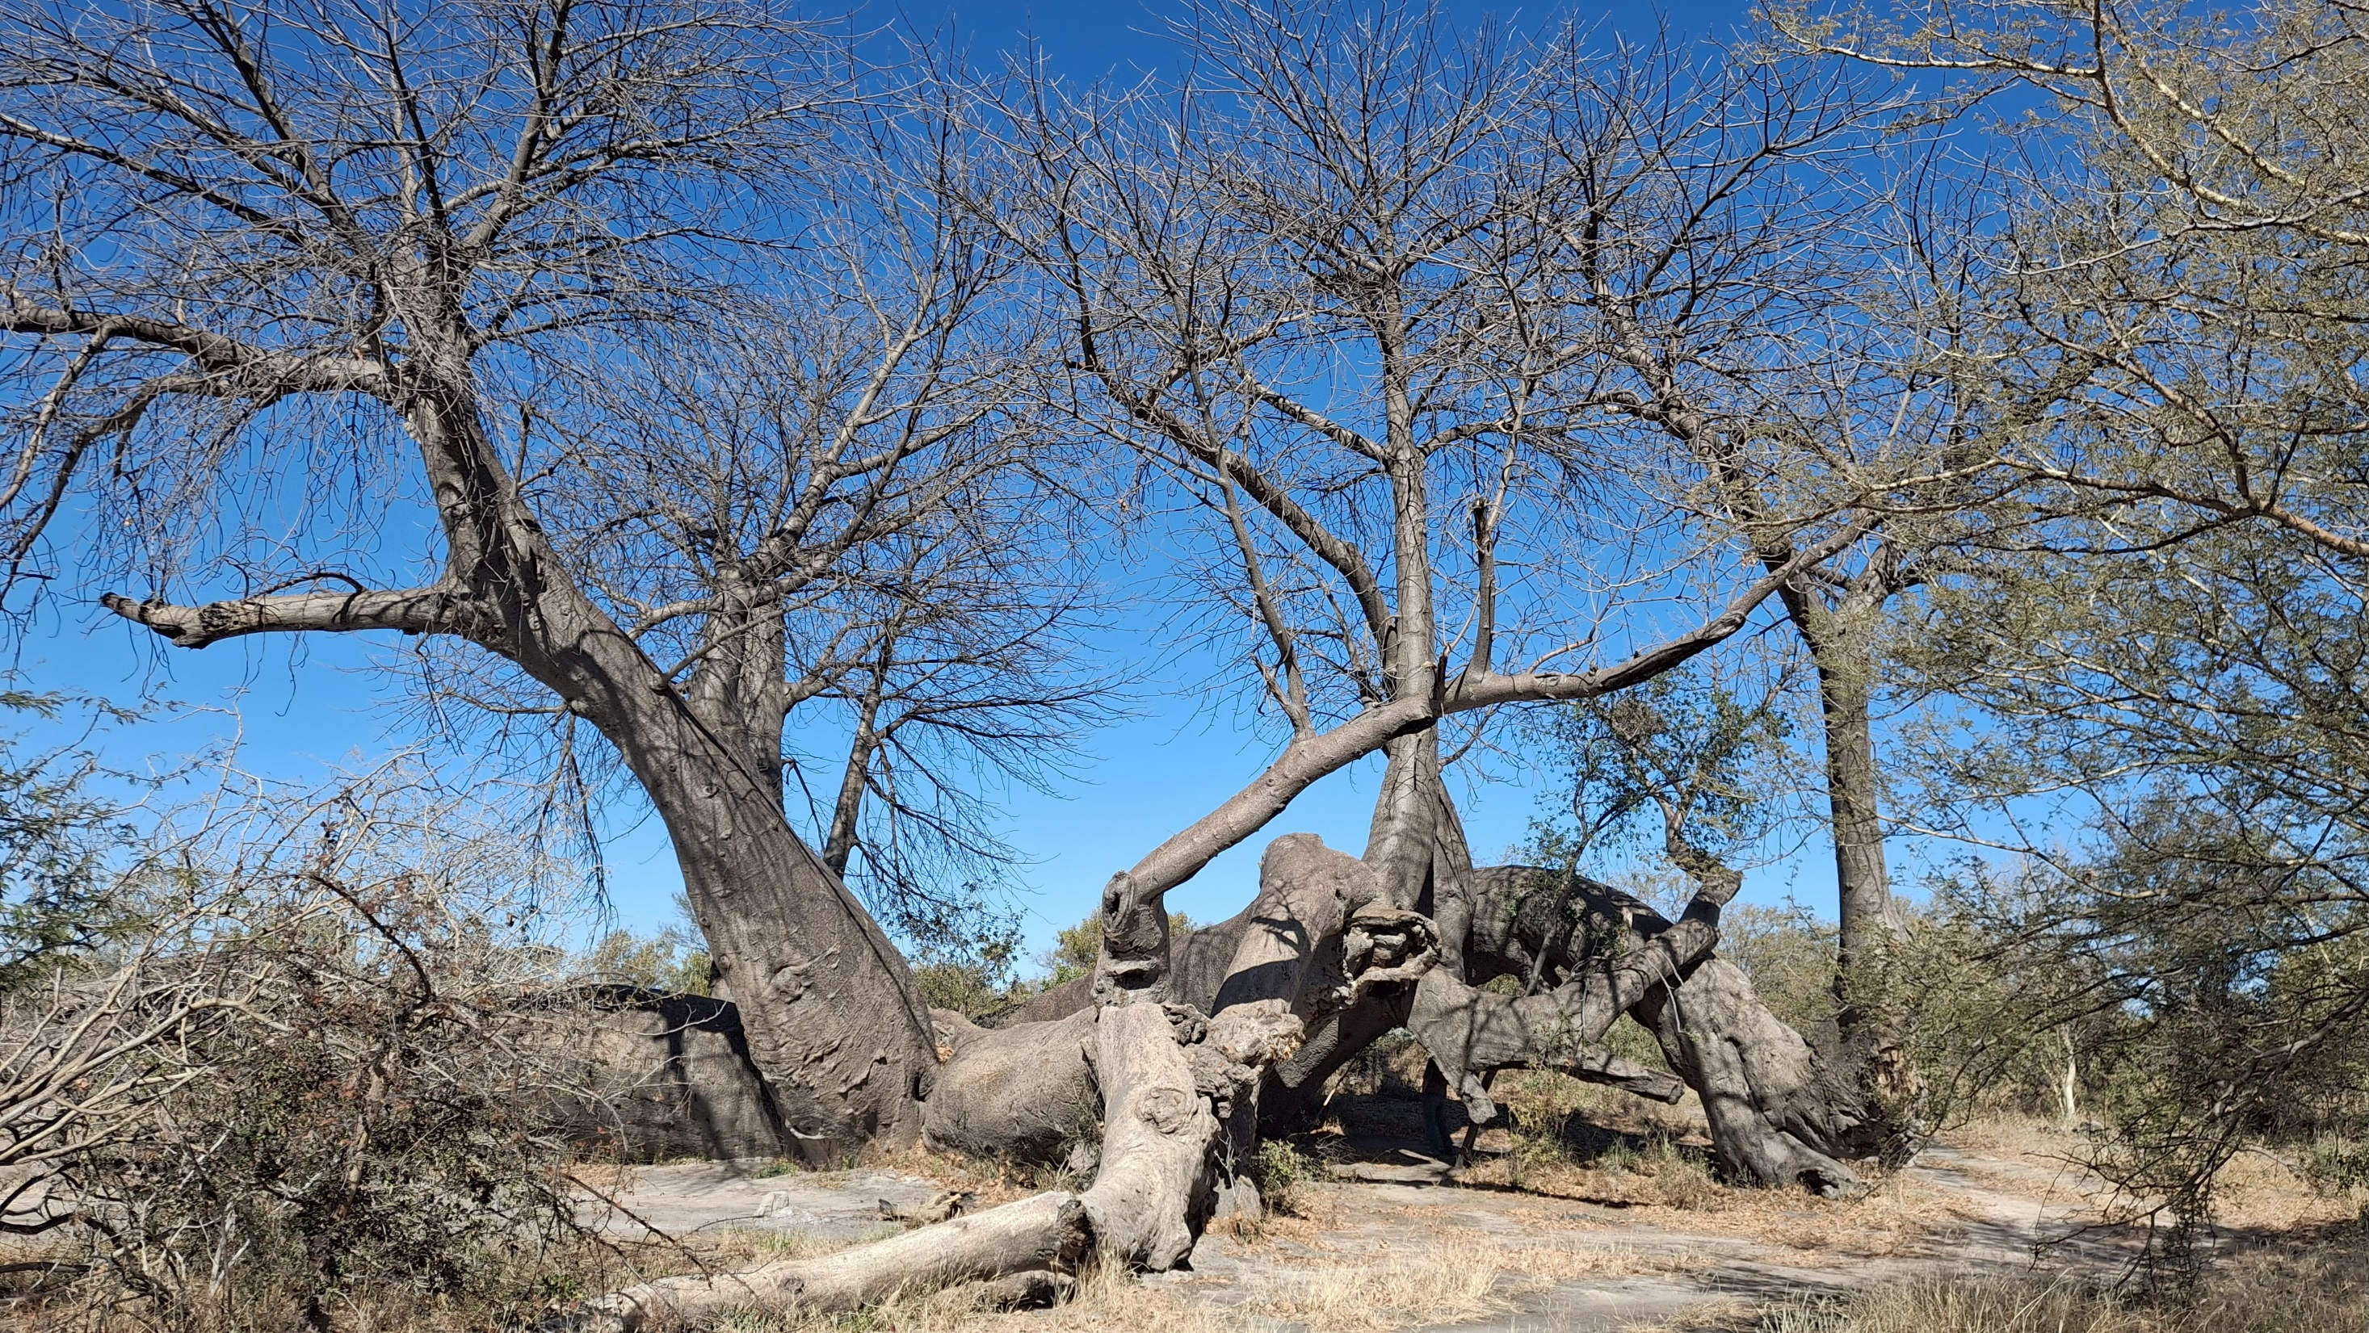
Dorsland Baobab
Biological attribute
SI = 231
Historical value
1883 (carving)
Tourism value

Slide 11
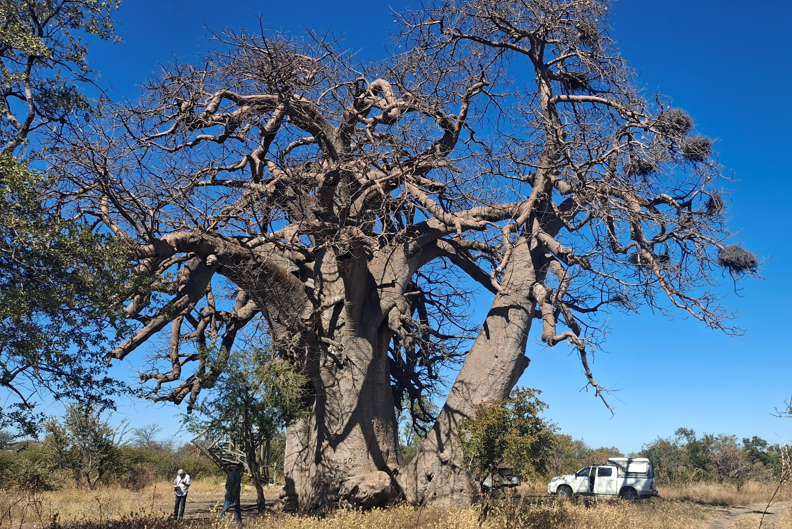
Baobab 10 km east of Tsumkwe
SI = 246
Biological attribute
Conservation
Tourism (Baobab trail)

Slide 12
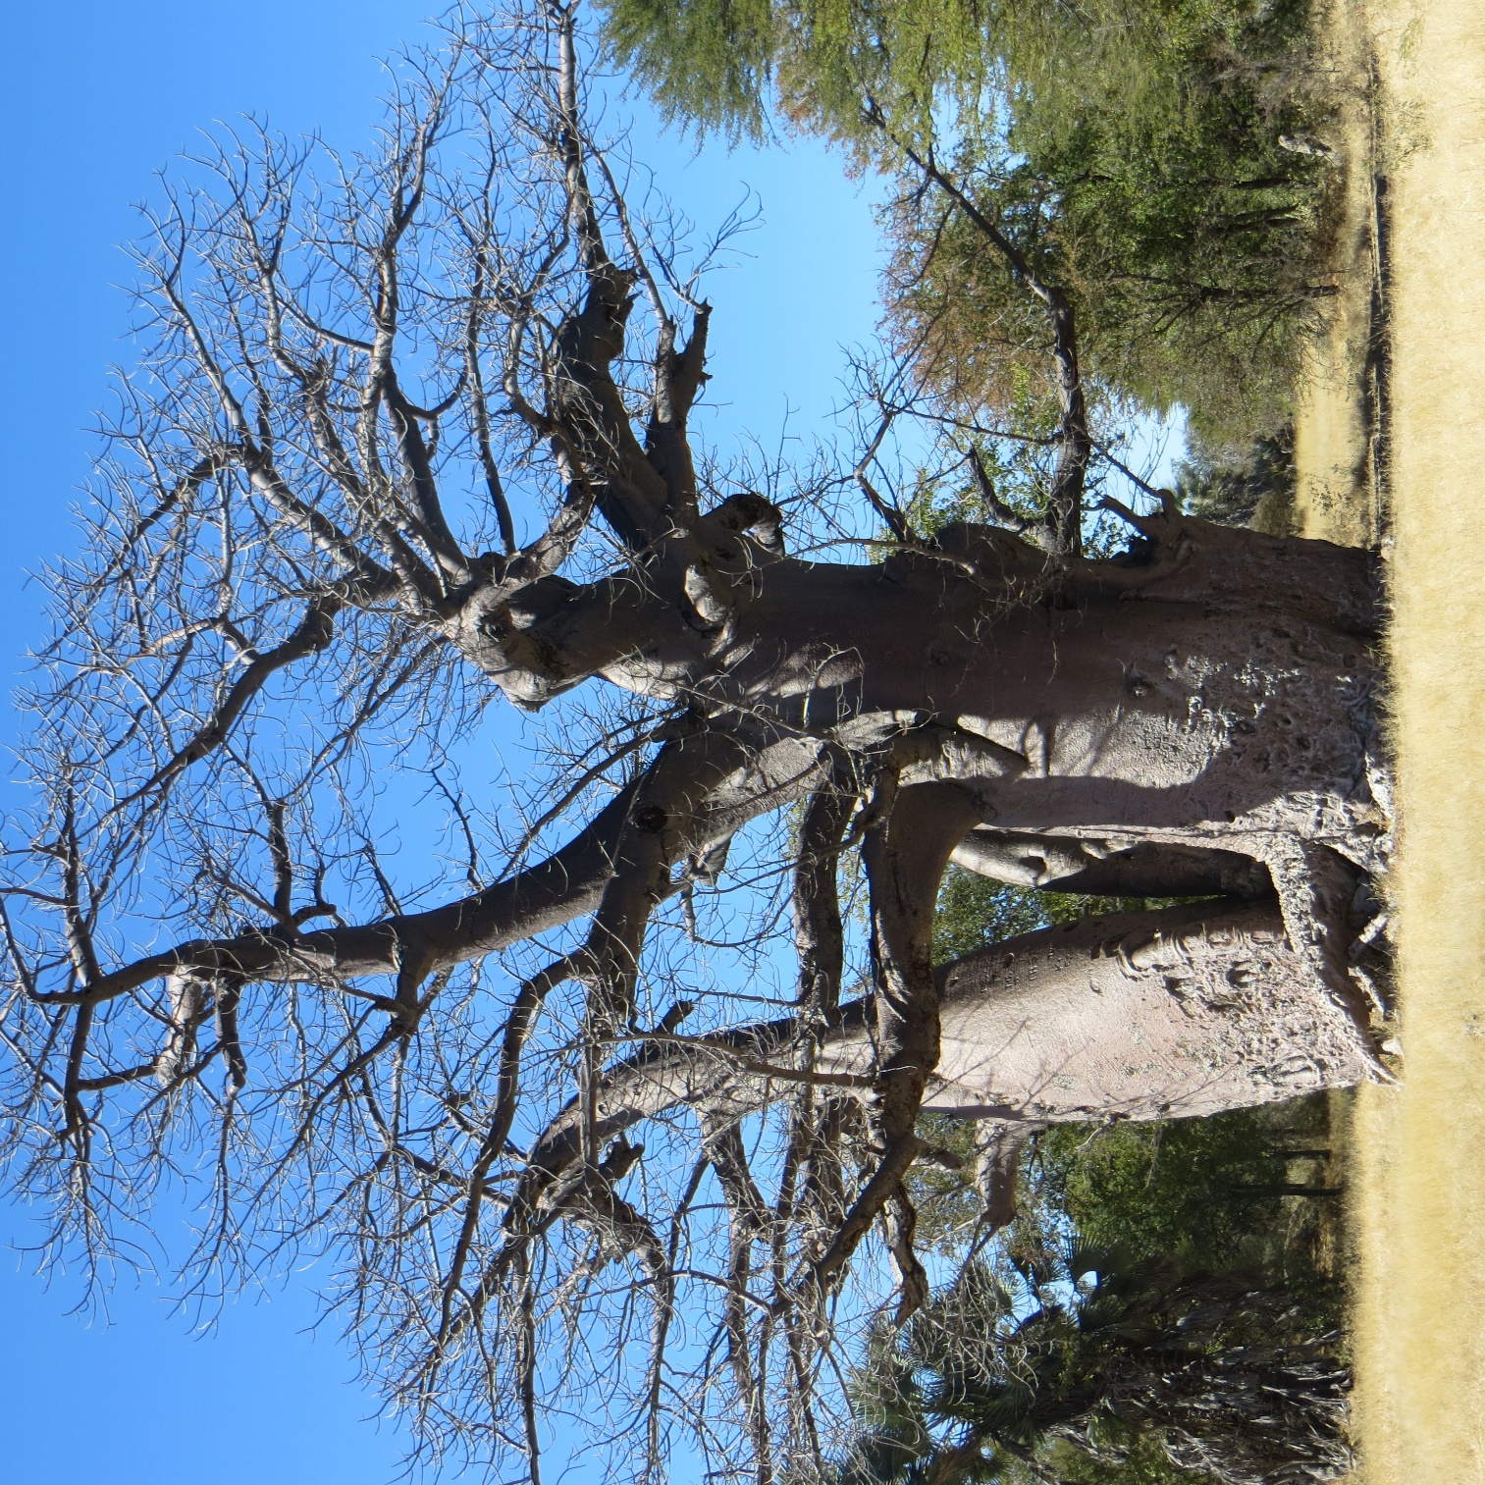
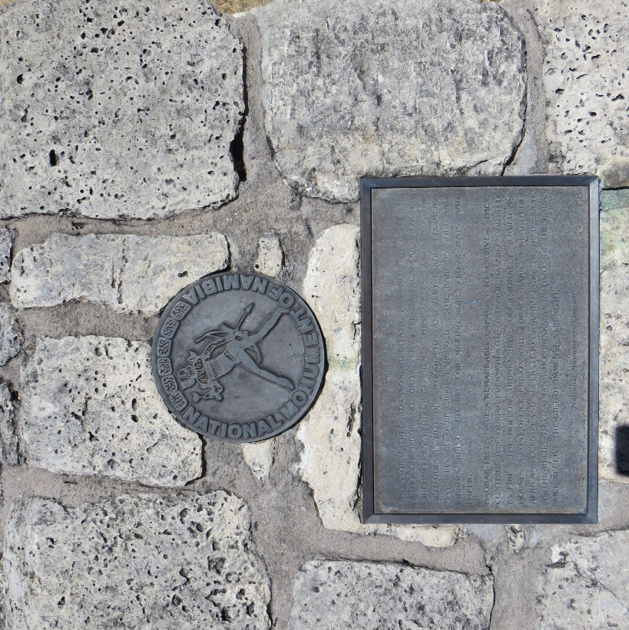
Tsintsabis Baobab (D3016)
Biological Attributes
SI = 253
Age
Historical value
National Monument 1951

Slide 13
Similar Champion tree registers exist in USA, Canada the UK and New Zealand
Can also simultaneously develop a register listing all the largest specimens of specific indigenous tree species
In SA the Department of Agriculture, Forestry and Fisheries is the custodian of the Champion Tree Project. These trees are protected under the National Forestry Act
In Namibia we also have a list of protected tree species and could then make out a case to include these Champion trees in the National legislation for protected species and can also be used as flagships for conservation

Slide 14
SI of Some other Trees in SA
Leadwood (Combretum imberbe)
SI = 184
Height = 19 m
Circumference = 6m
Tambotie (Spirostachys africana)
SI = 88
Height = 16.6 m
Measured one in Namibia (SI = 40, Height = 17.6 m)

Slide 15
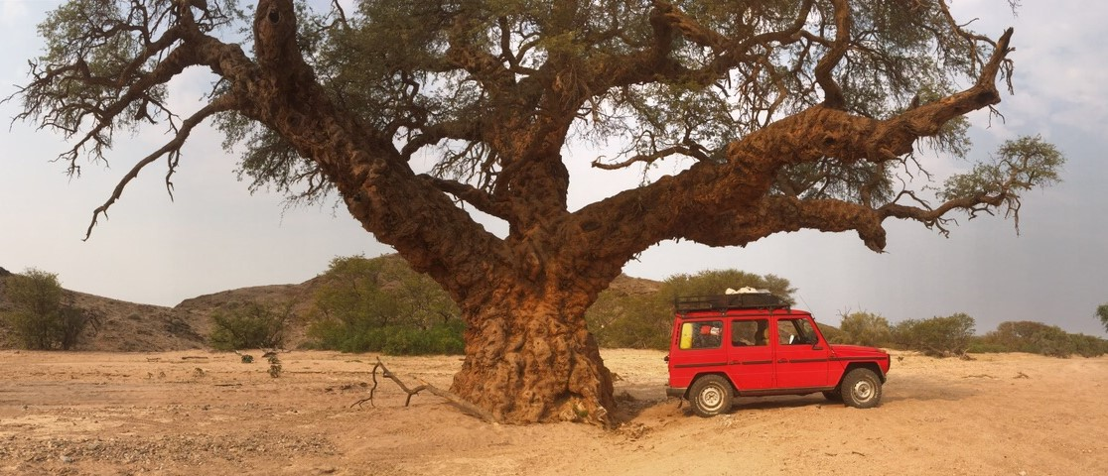
Camelthorn in Aba huab

Slide 16
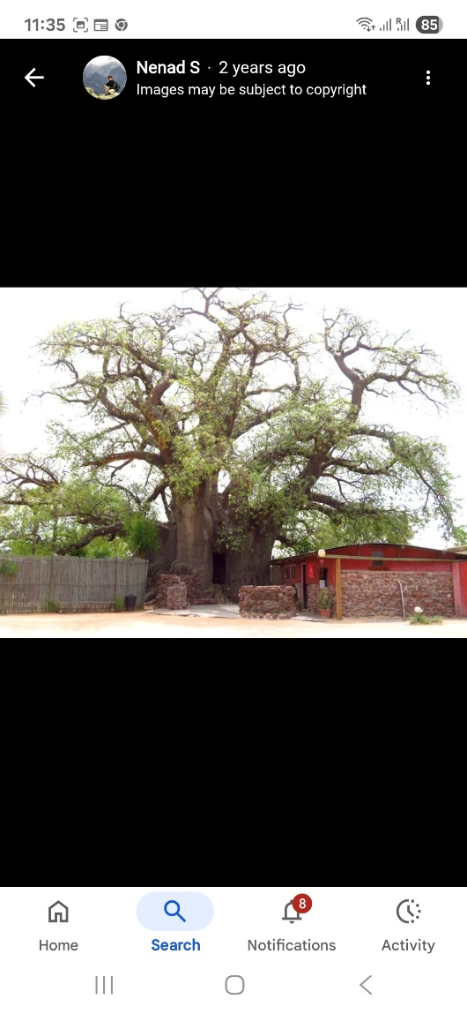
Ombalantu Baobab
Outapi
Used as a hiding place during conflict
Post office
Church
Kindergarten

Slide 17
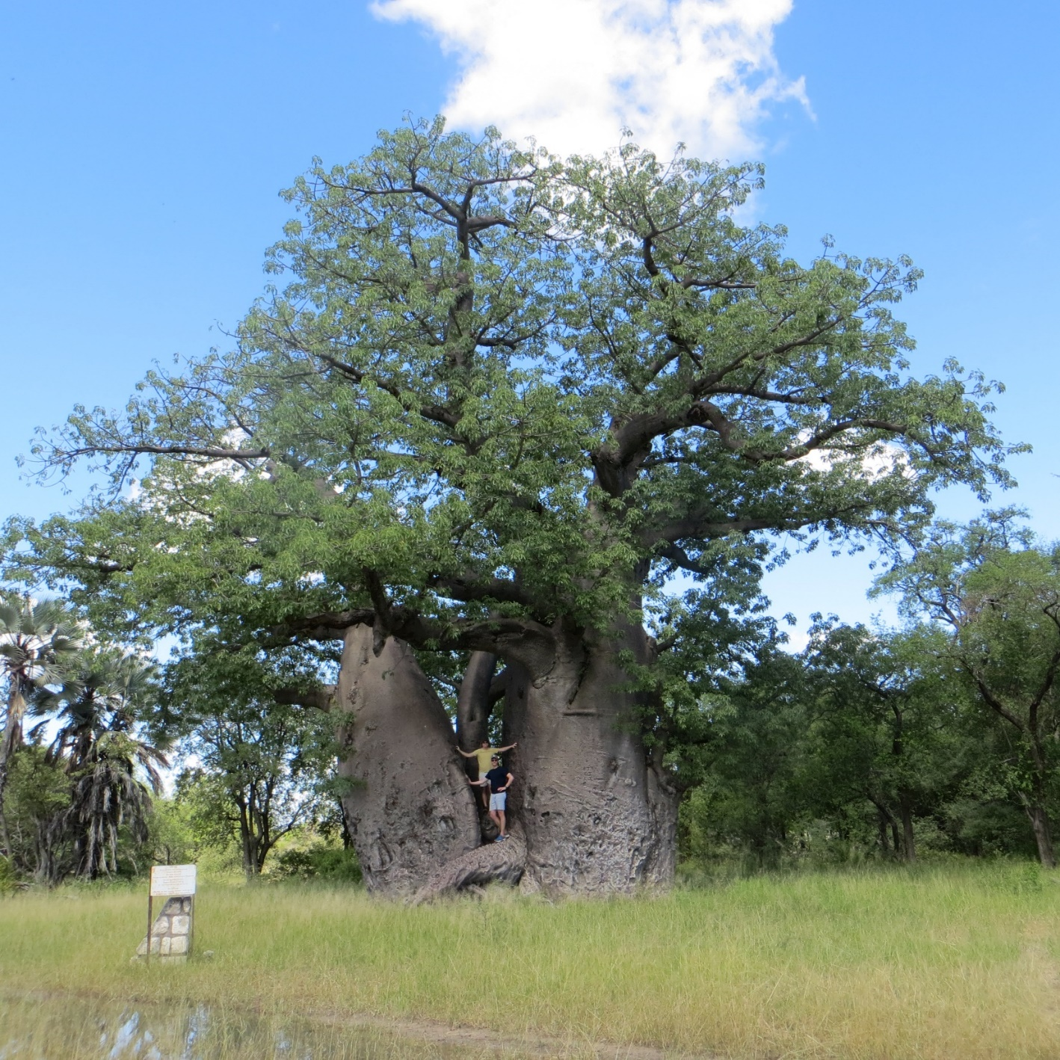
What Project will entail:
Determine the criteria for Namibia
Identify potential trees
Measure trees
Draw up a register
Map with GPS references
Signage and QR codes with linked
info at trees on site

Slide 18
How can you be involved?
Need to decide on the criteria
eg. only indigenous?
Same SI as SA?
Also do a Register of largest specimens of tree spp…..only protected?
Identifying potential exceptional trees that are worthy of special protection
Heritage aspects of trees not always recorded only known by individuals and local communities
Advertise, awareness

Slide 19
Why is this a worthwhile project?
This project has the potential to:
recognize and protect individual or groups of trees based on size, age or historical value
create a National Champion tree database
provide legal protection for trees by including them in the Forestry Act’s list of protected species
Compile a National Register of Big trees of Namibia, recording largest specimen of each spp.
inspire national pride
support conservation
promote tourism
safeguard some of Namibia’s most remarkable natural treasures
https://botsoc.org.na/our-projects/living-legends/

Slide 20
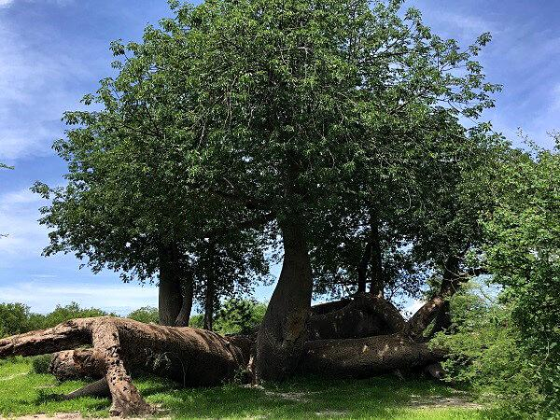
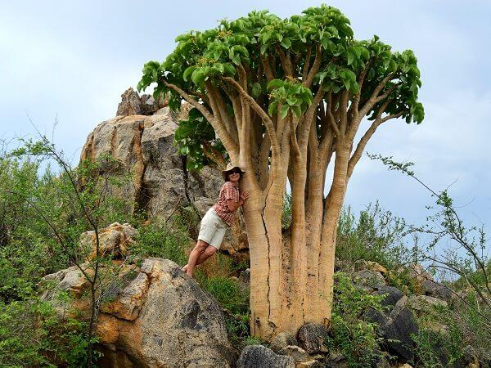
Living Legends

Slide 21
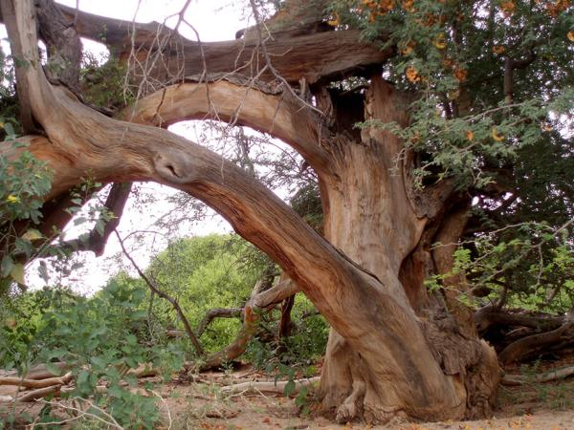
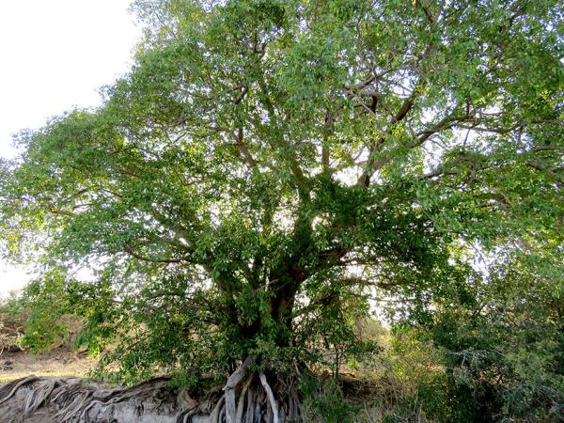
Living Legends

Slide 22
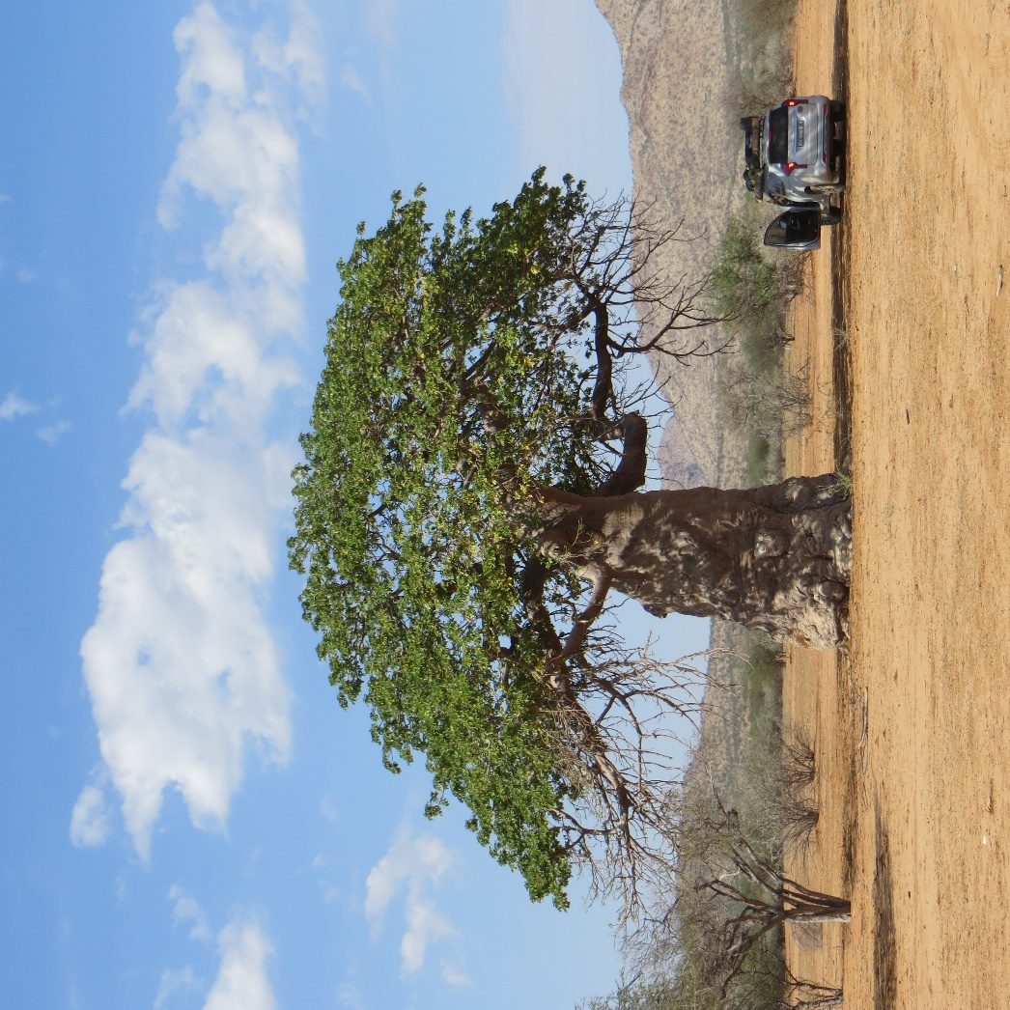
WhattsApp +264 81 127 3958
carolsteenkamp@gmail.com

